Slide 1
Introduction to Computing for Data Analysis
Compression via PCA+SVD
Richard Vuduc, Ph.D.
Associate Professor
School of Computational Science and Engineering
Principal components analysis
Notes:
Hi again, and welcome back.
In this lesson, I want you to solve the problem of finding a set of axes that maximizes the projections of the original data.
This problem is also known as *principal component analysis.*

Slide 2
Introduction to Computing for Data Analysis
Compression via PCA+SVD
Richard Vuduc, Ph.D.
Associate Professor
School of Computational Science and Engineering
Principal components analysis
Notes:
Solving the problem produces some axes, which are the *principal components.*
Once you’ve got them, you can compress original data by picking the number of principal components you want and projecting the original data onto them.
The results of the projection are a new, lower-dimensional approximation of the original data.

Slide 3

Notes:
Recall the idea of maximizing projections. @TODO: Show title

Slide 4
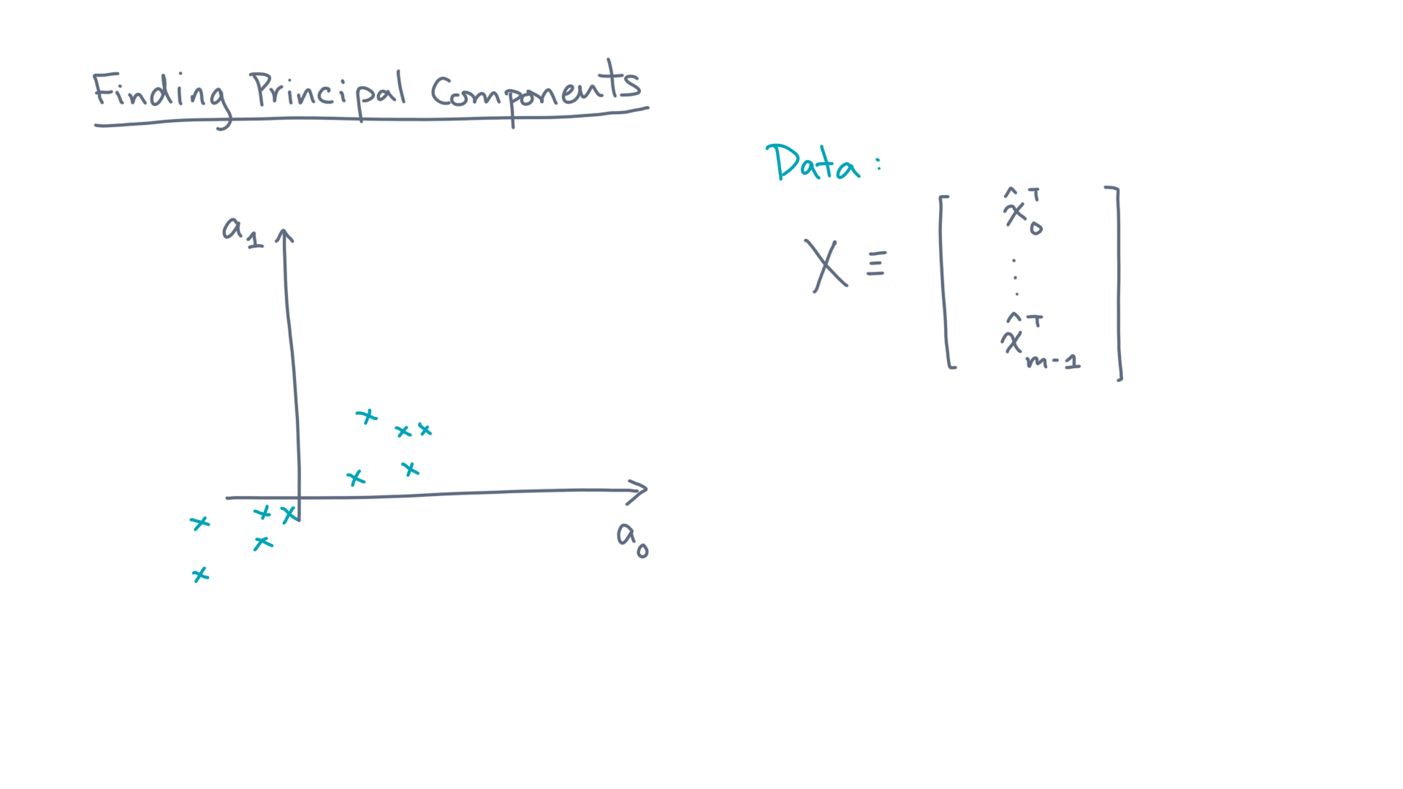
Notes:
You are given a data set, whose coordinates are stored in the data matrix, X. @TODO: Show
Assume these points are mean-centered.

Slide 5
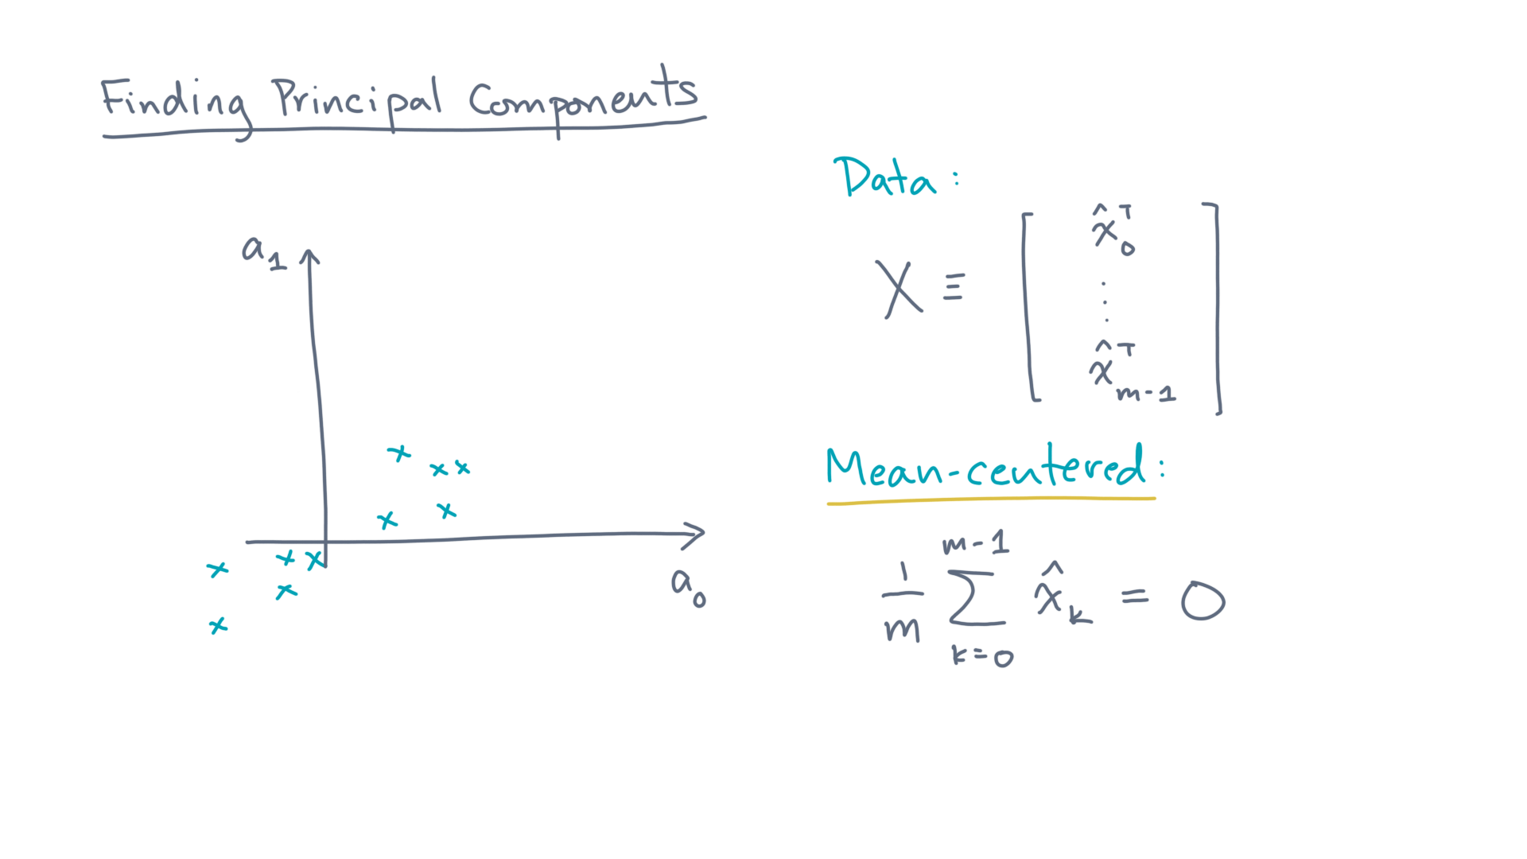
Notes:
Assume these points are mean-centered. @TODO: Show

Slide 6
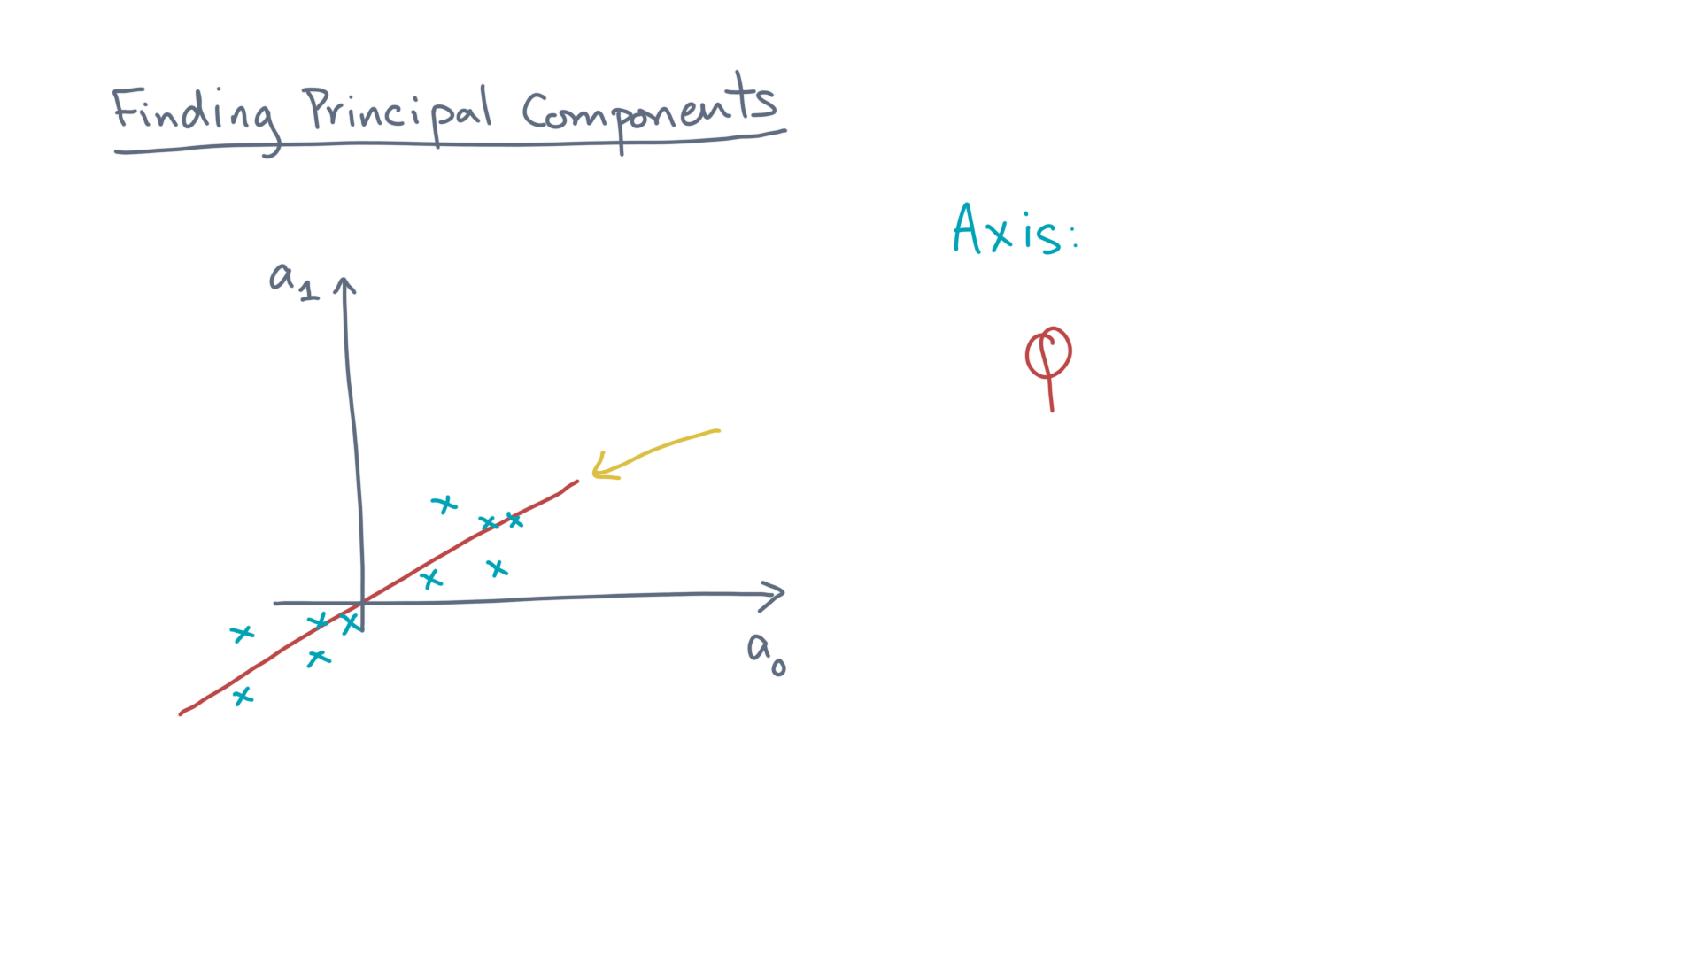
Notes:
You want to find an axis, phi. @TODO: Draw axis

Slide 7
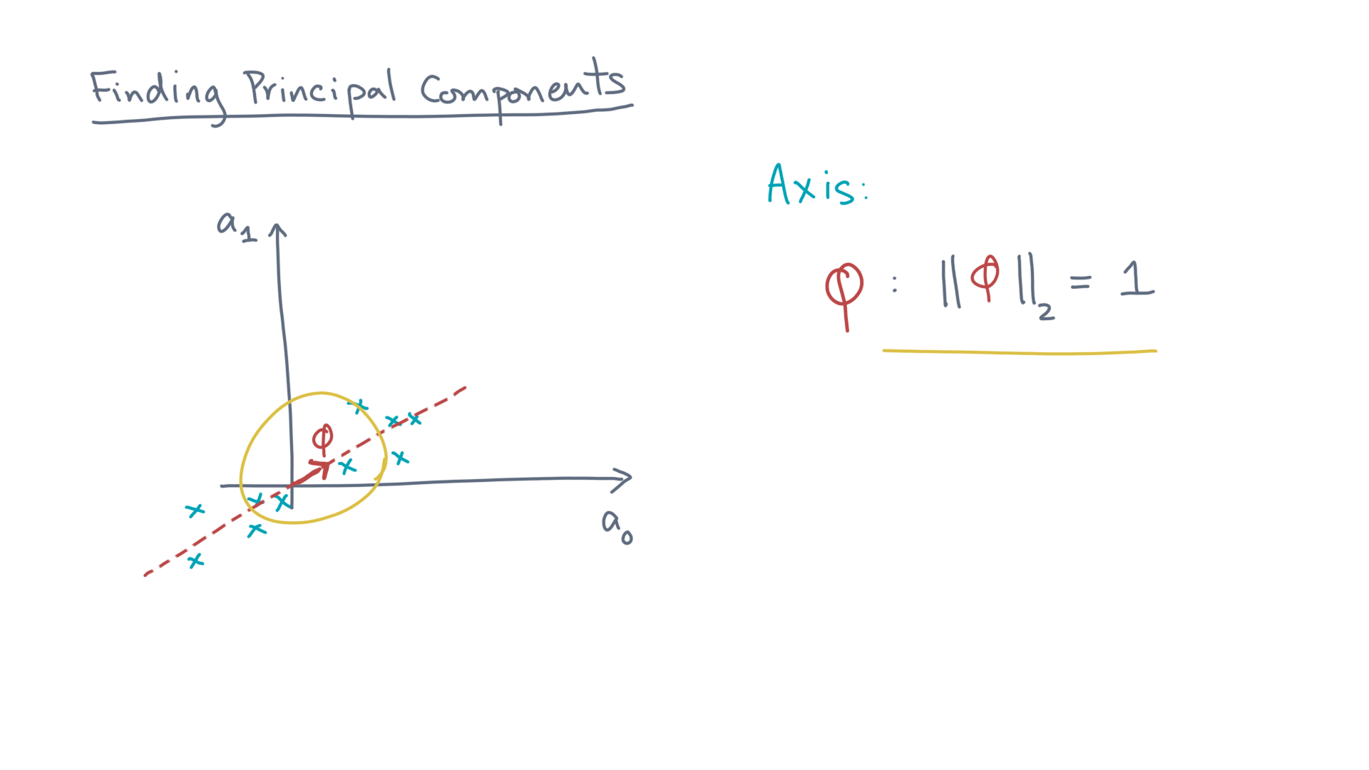
Notes:
Consider phi to be a unit vector, which represents the axis. @TODO: Show length constraint

Slide 8
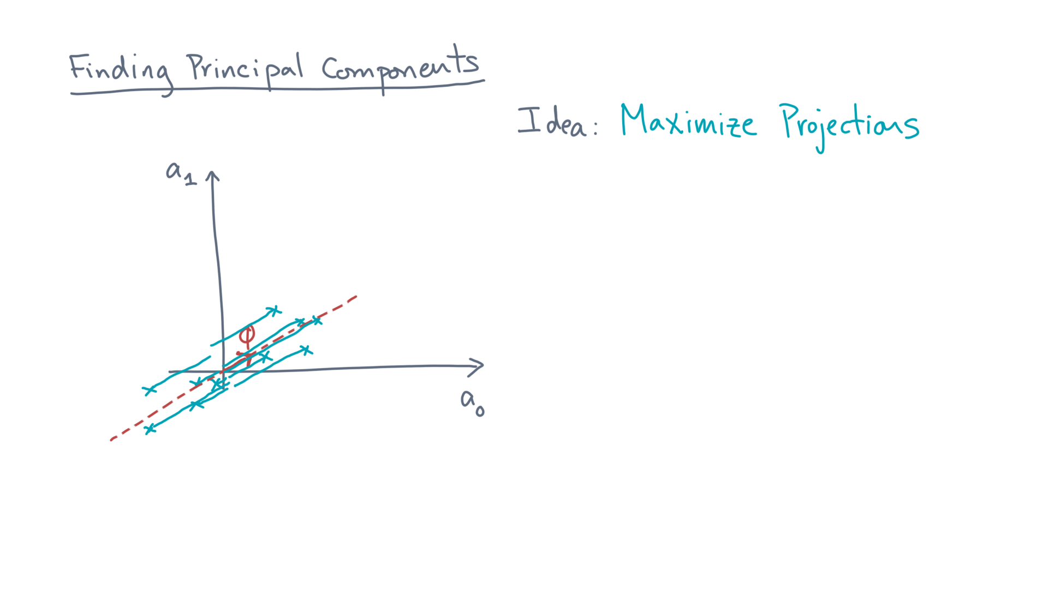
Notes:
Now, which phi do you want? @TODO: Draw projections
One idea is to maximize the projections of the original data onto it.

Slide 9
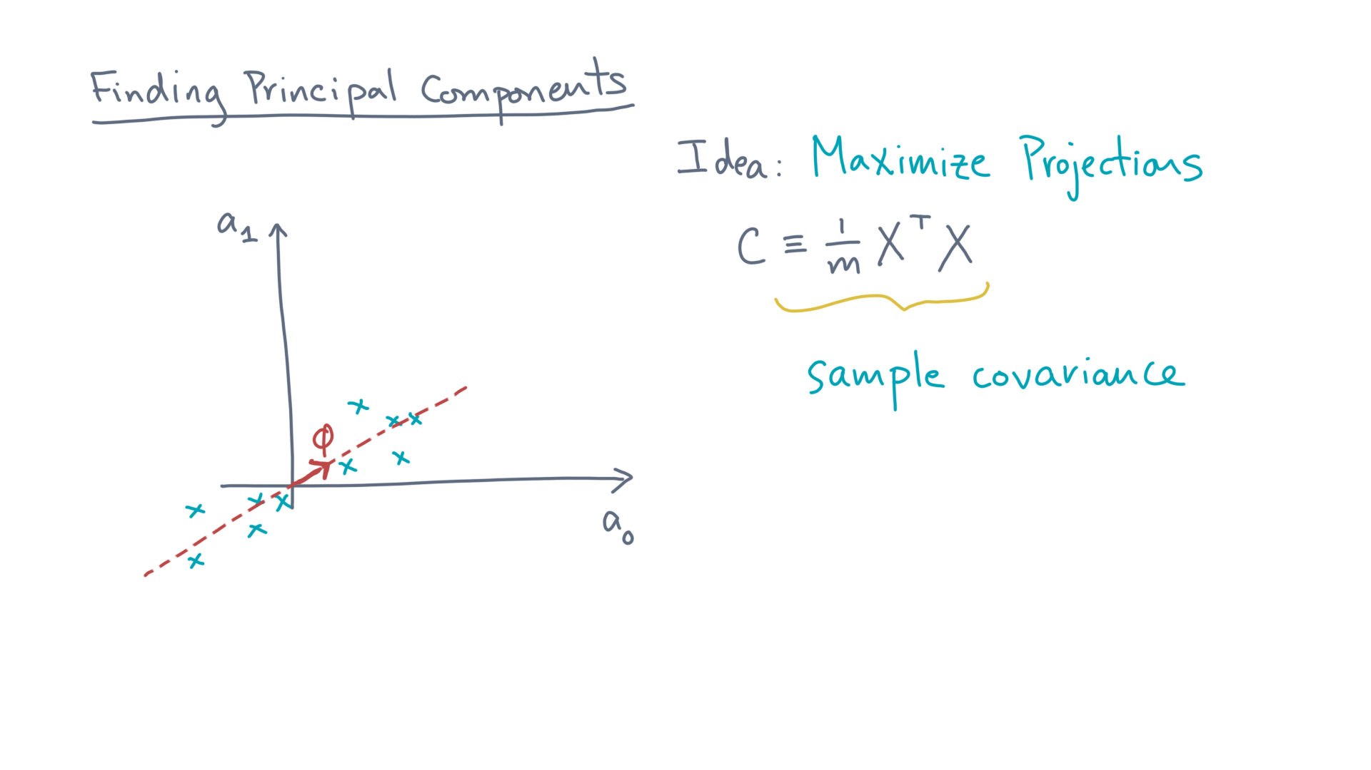
Notes:
Let C be the sample covariance matrix corresponding to this mean-centered data. @TODO: Show

Slide 10
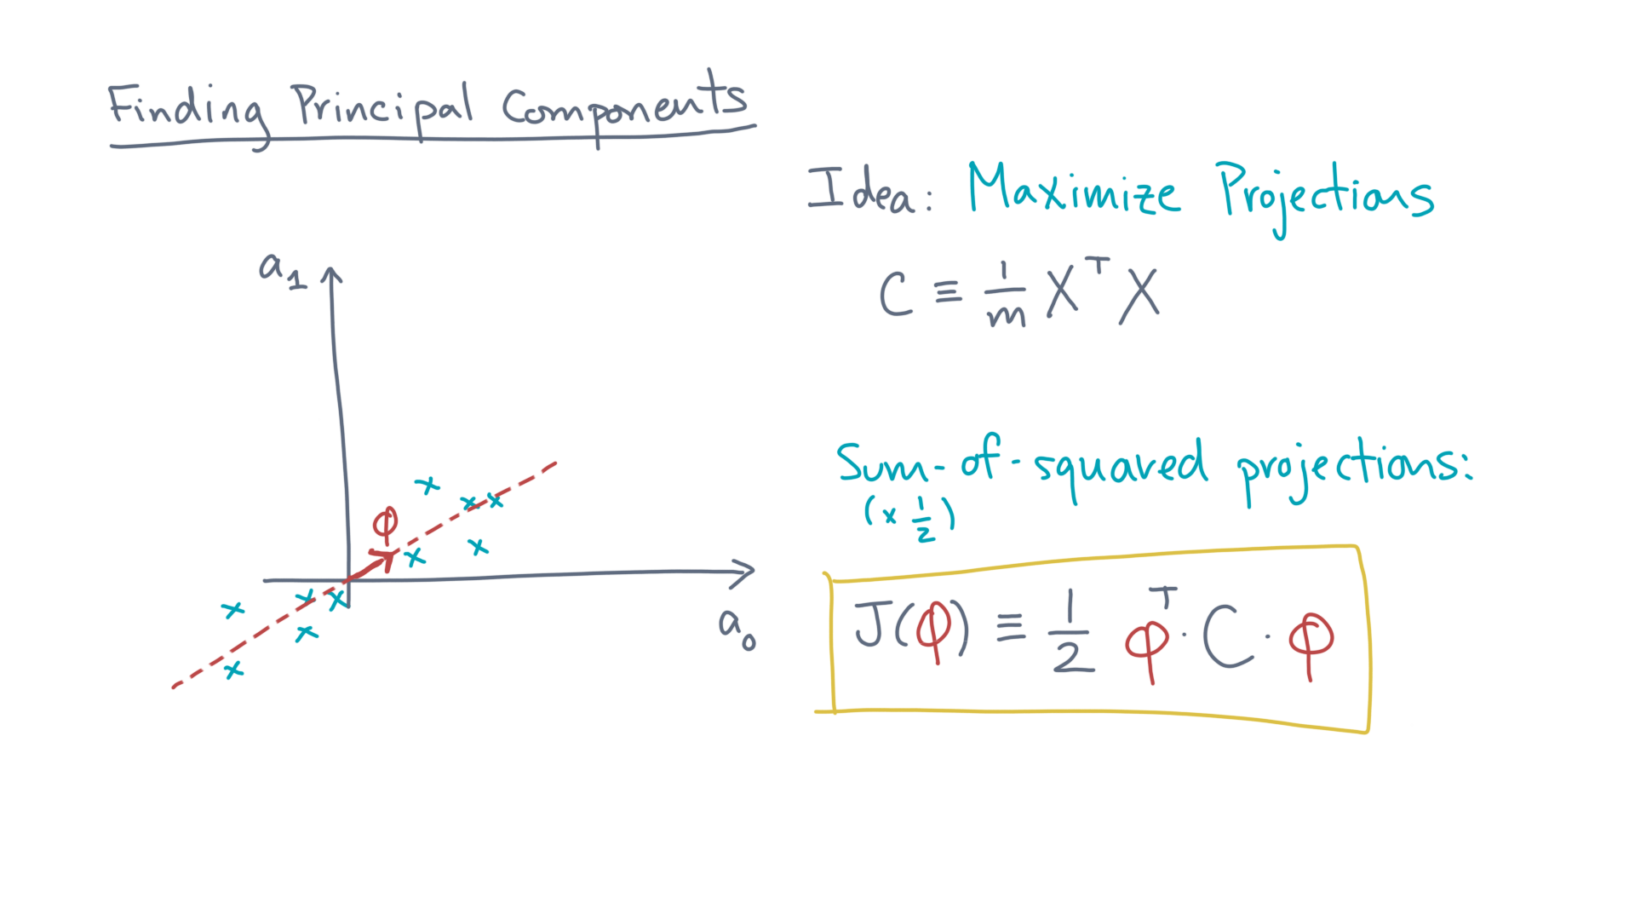
Notes:
Then an objective function that expresses this idea is the sum-of-squared projections: @TODO Show formula
J(phi) equals one-half phi-transpose times C times phi.
The one-half is for aesthetic reasons, as you’ll soon see.

Slide 11
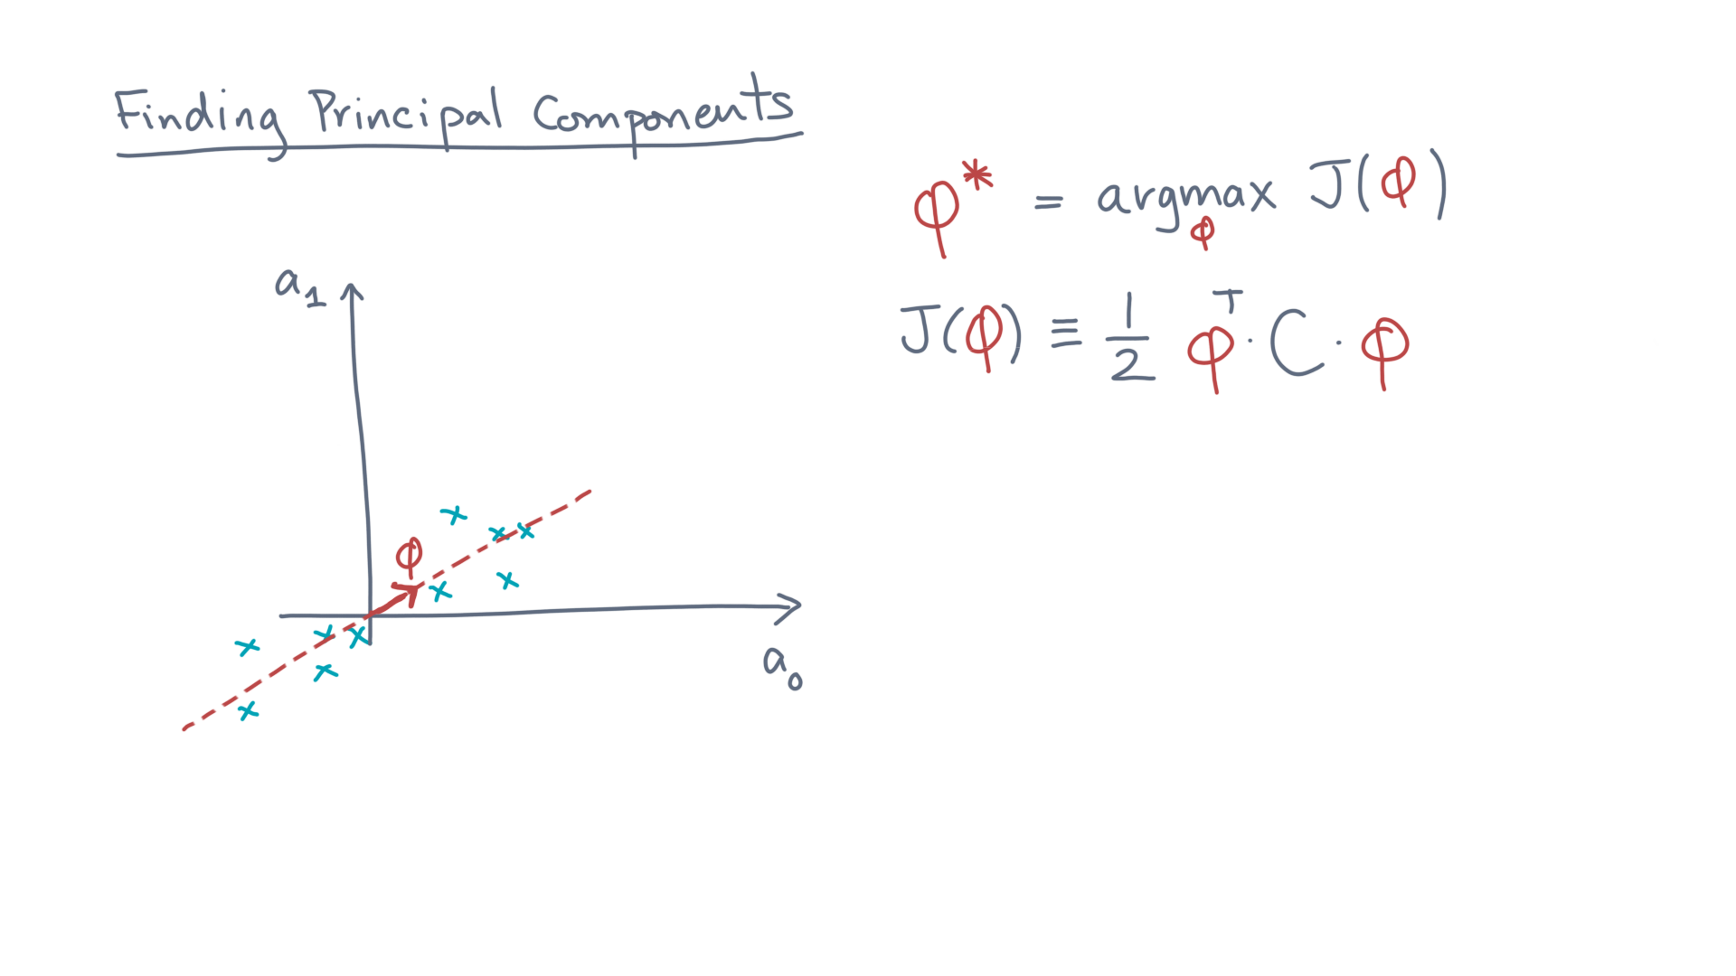
Notes:
So how do you maximize this function?

Slide 12
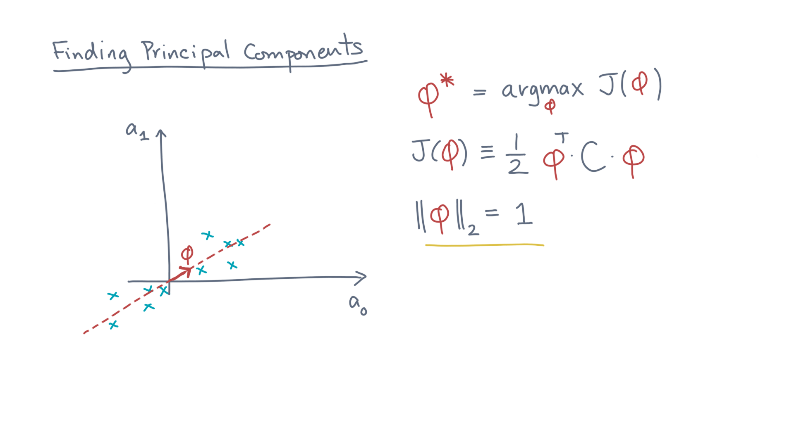
Notes:
This normalization is an important constraint to consider.
Let me rewrite it into an equivalent form.

Slide 13
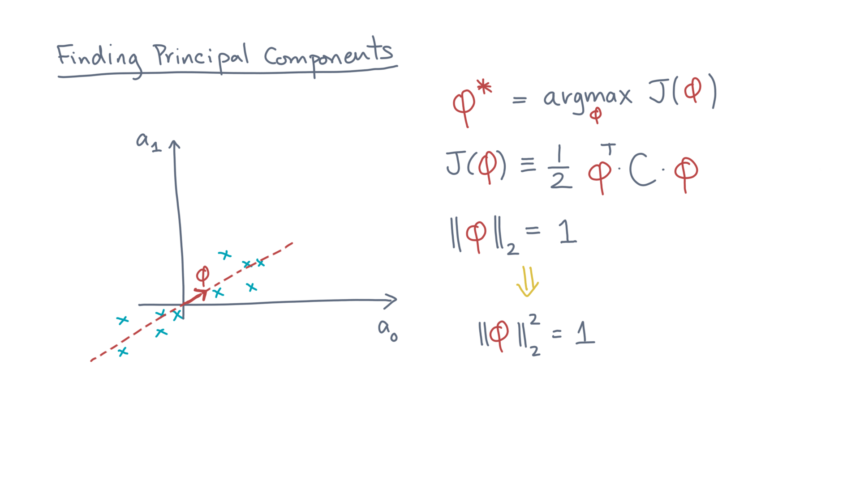
Notes:
And, once more.

Slide 14
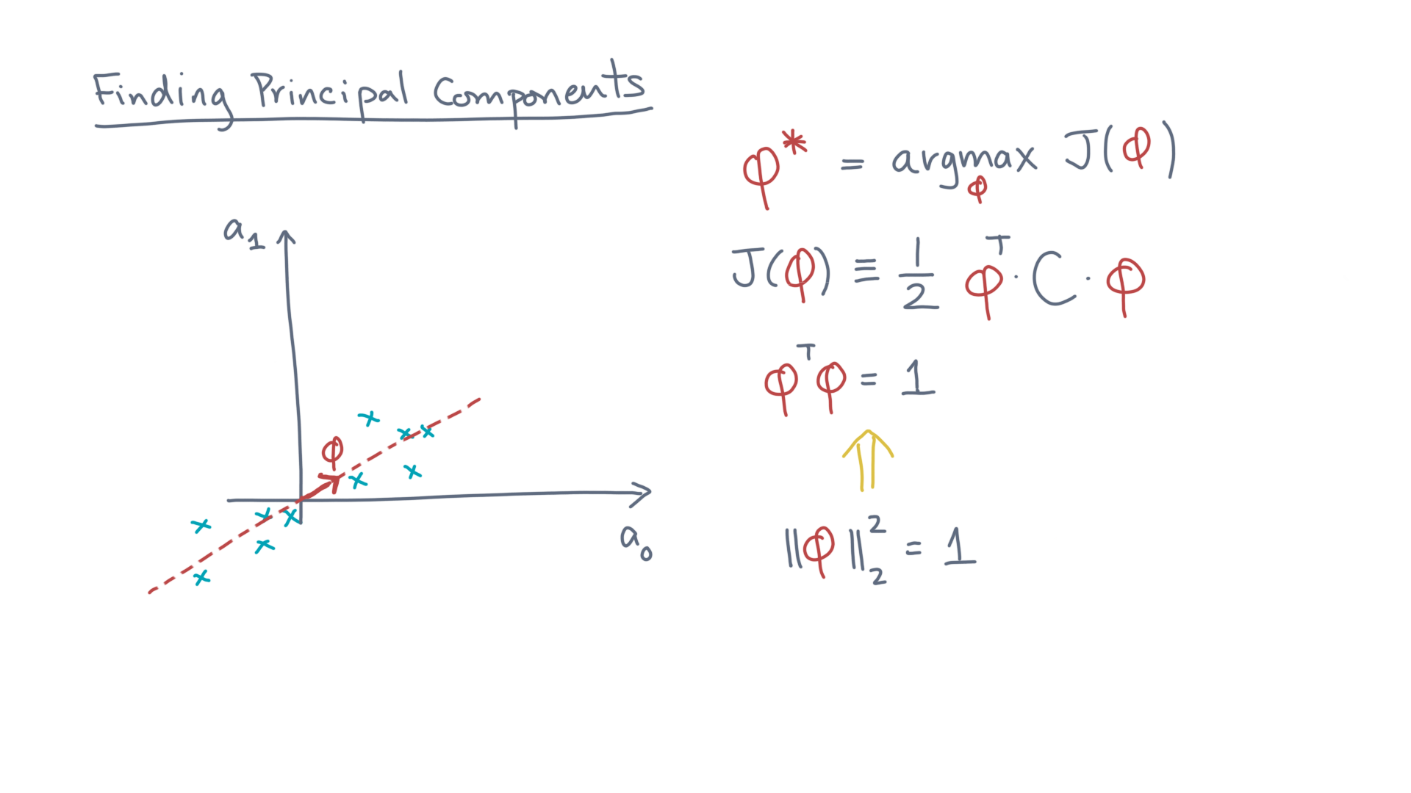
Notes:
That is, phi-transpose-phi equals one.

Slide 15
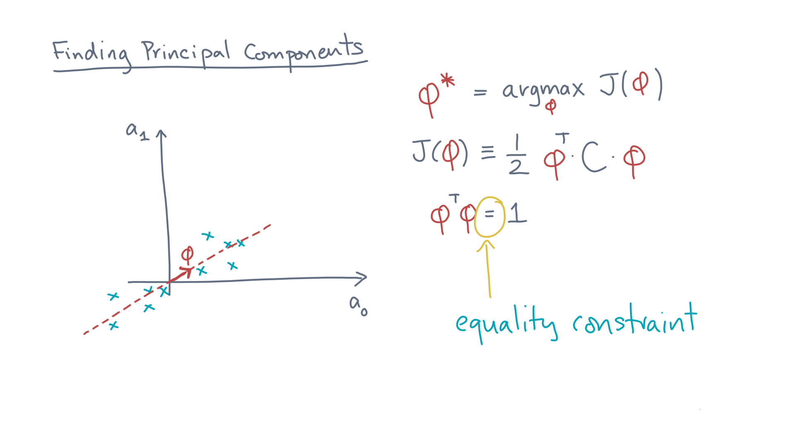
Notes:
It’s an *equality constraint* on the maximization problem, since we need some variable to be exactly equal to a specific value.
So how do we incorporate it?

Slide 16
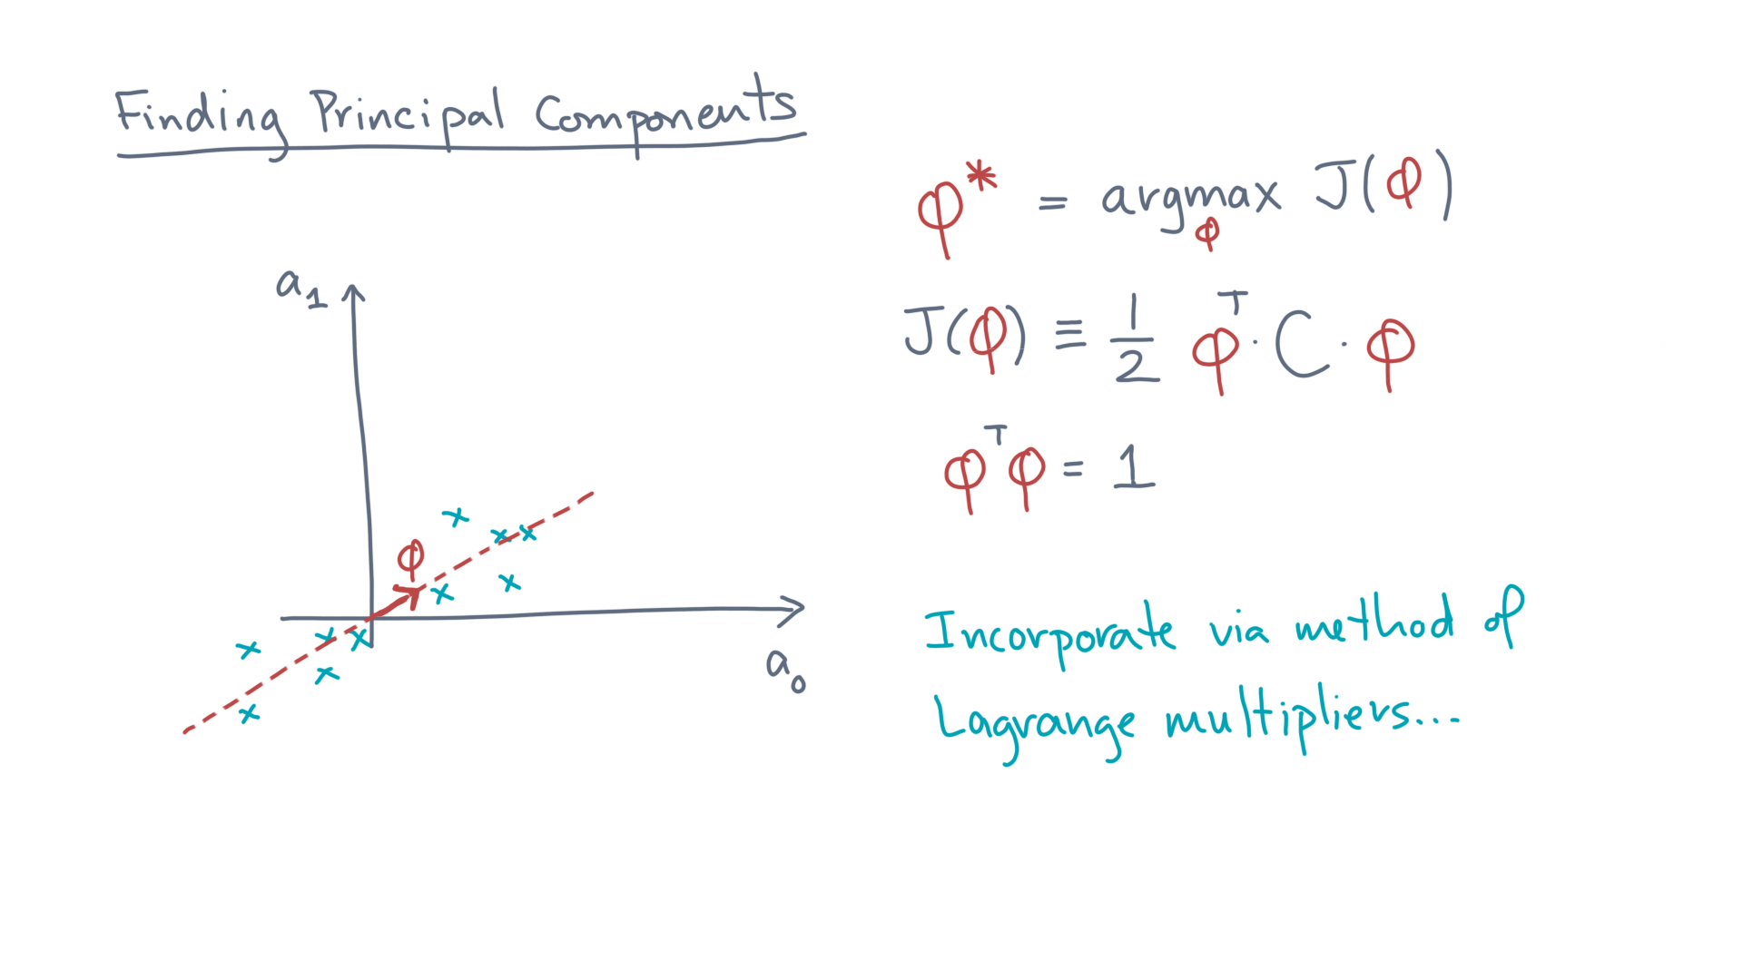
Notes:
There is a mathematical trick, known as the method of Lagrange multipliers.
Let’s see how it goes.

Slide 17
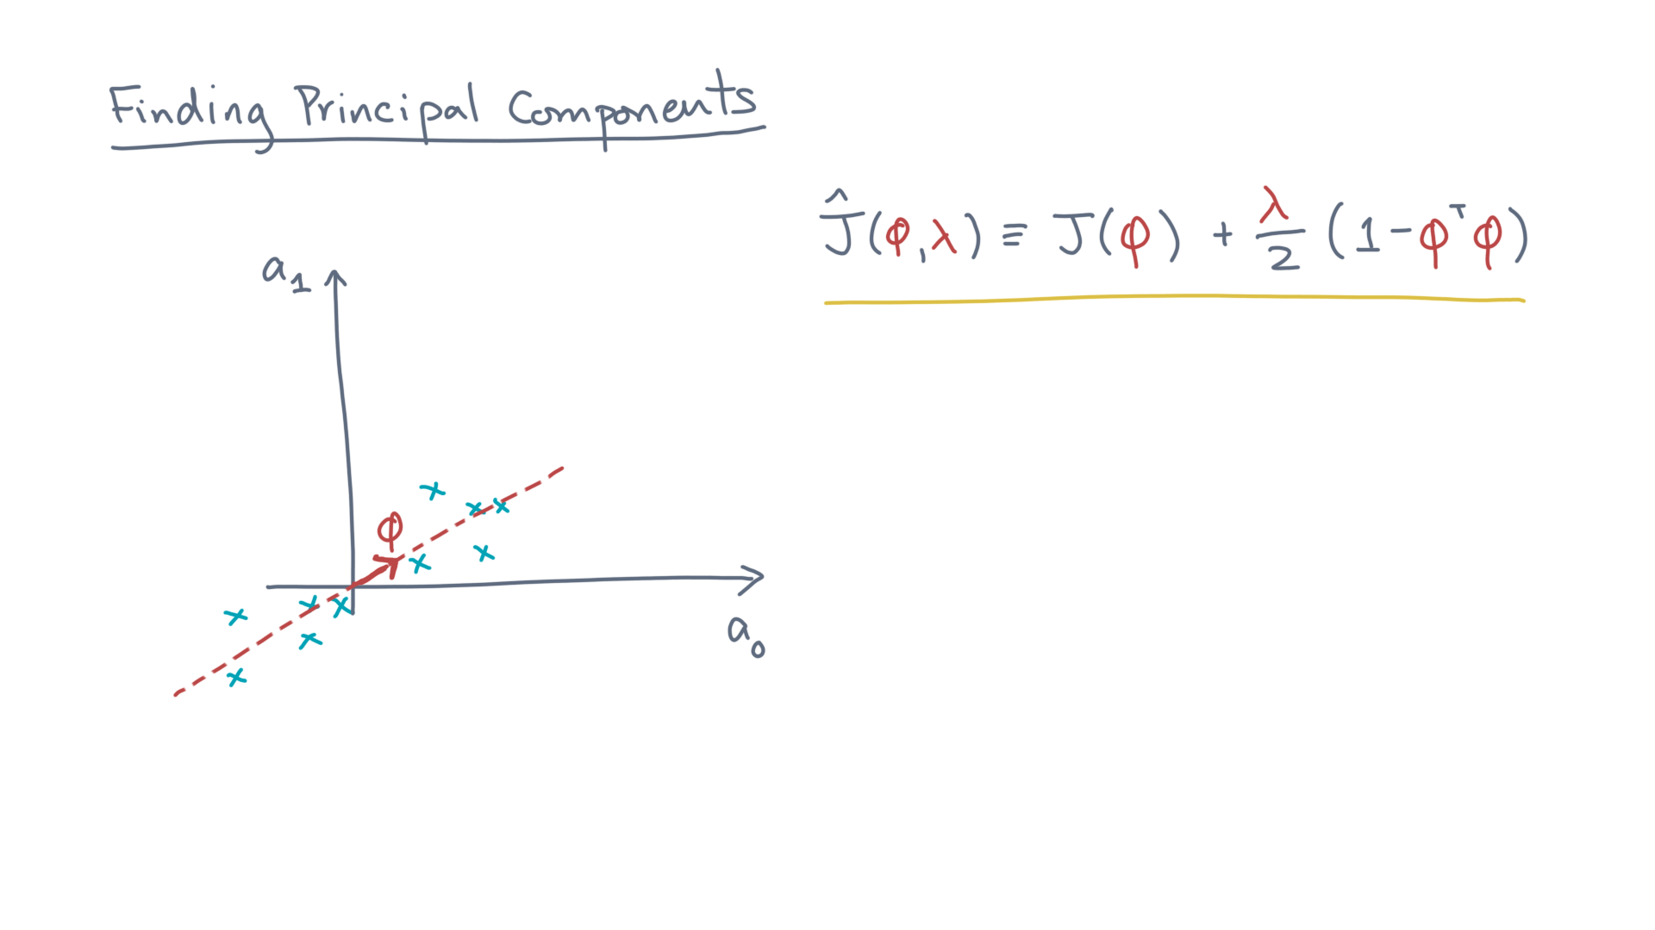
Notes:
Let J-hat of phi and lambda to be J of phi *plus* lambda over two times the quantity one minus phi-transpose-phi. @TODO Show

Slide 18
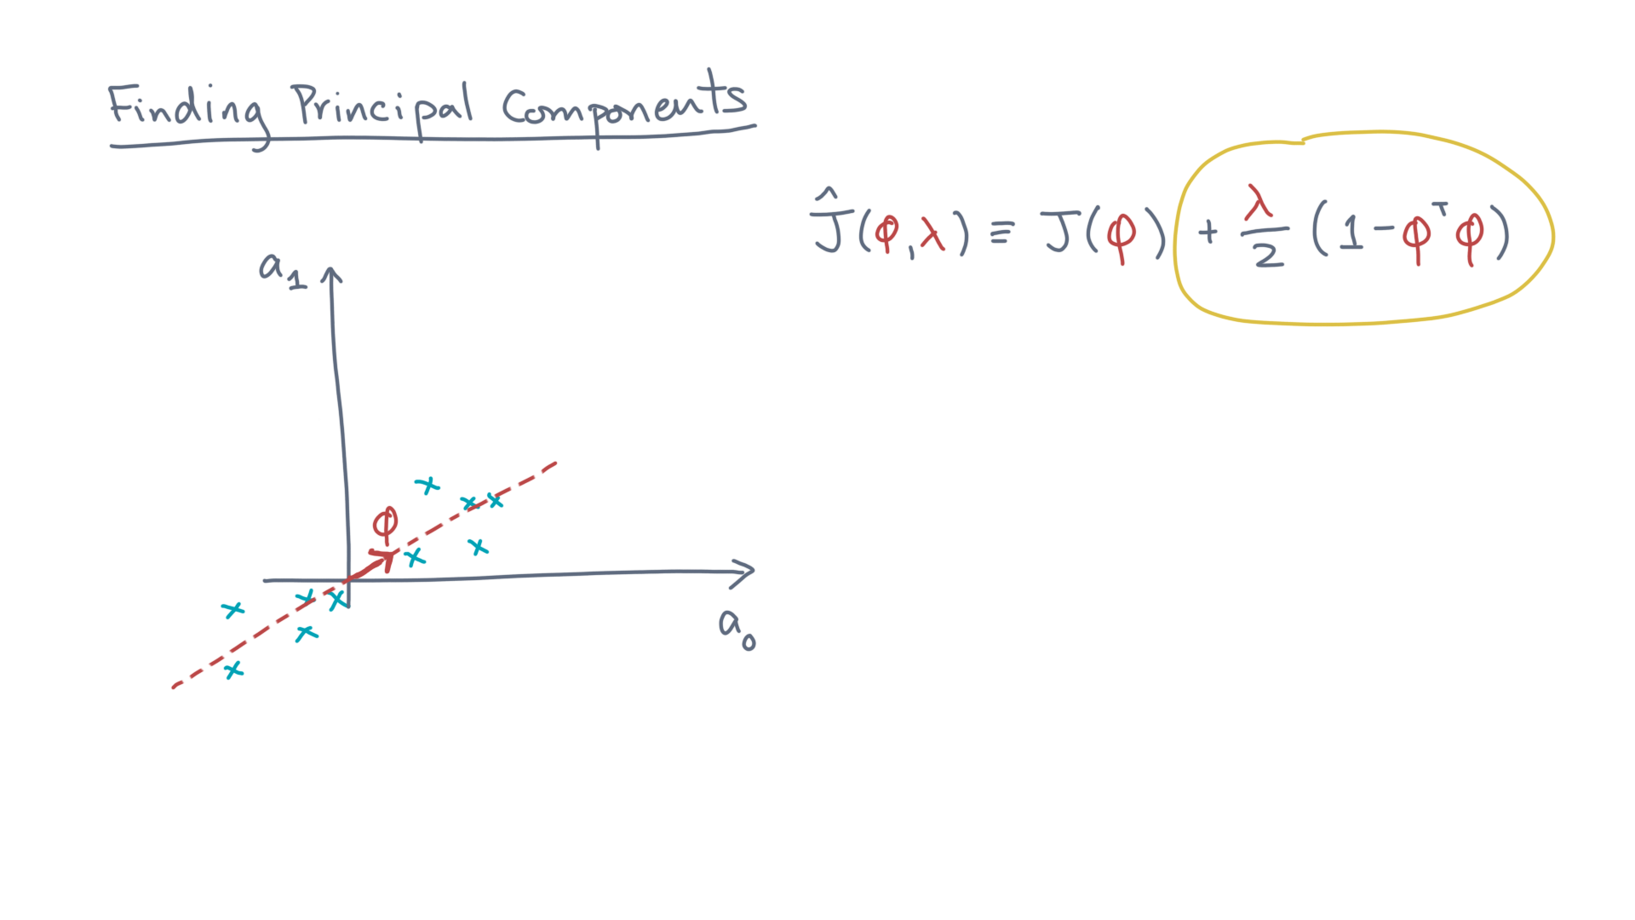
Notes:
It’s just like the original, except for this extra term. @TODO: Highlight term

Slide 19
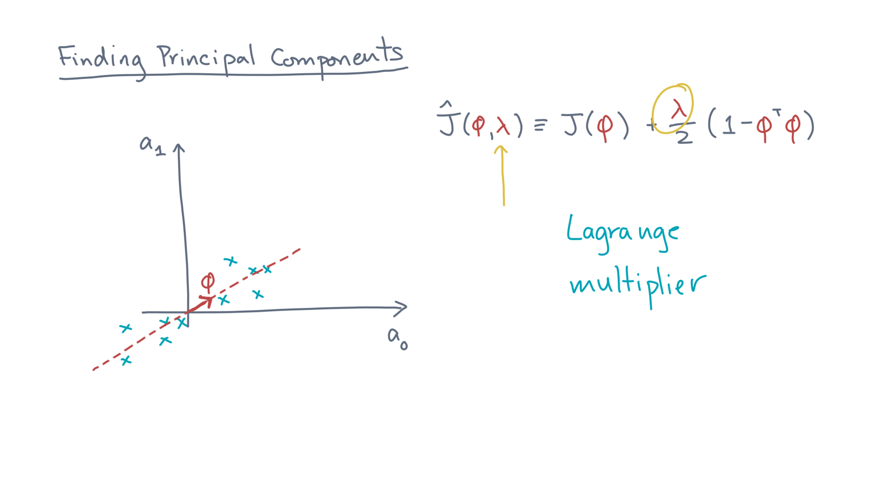
Notes:
Lambda is a dummy parameter, referred to as a Lagrange multiplier. @TODO: Highlight lambda, write term “Langrange multiplier”
You’ll see how it works soon, but for the moment, just consider it an additional parameter to optimize.

Slide 20
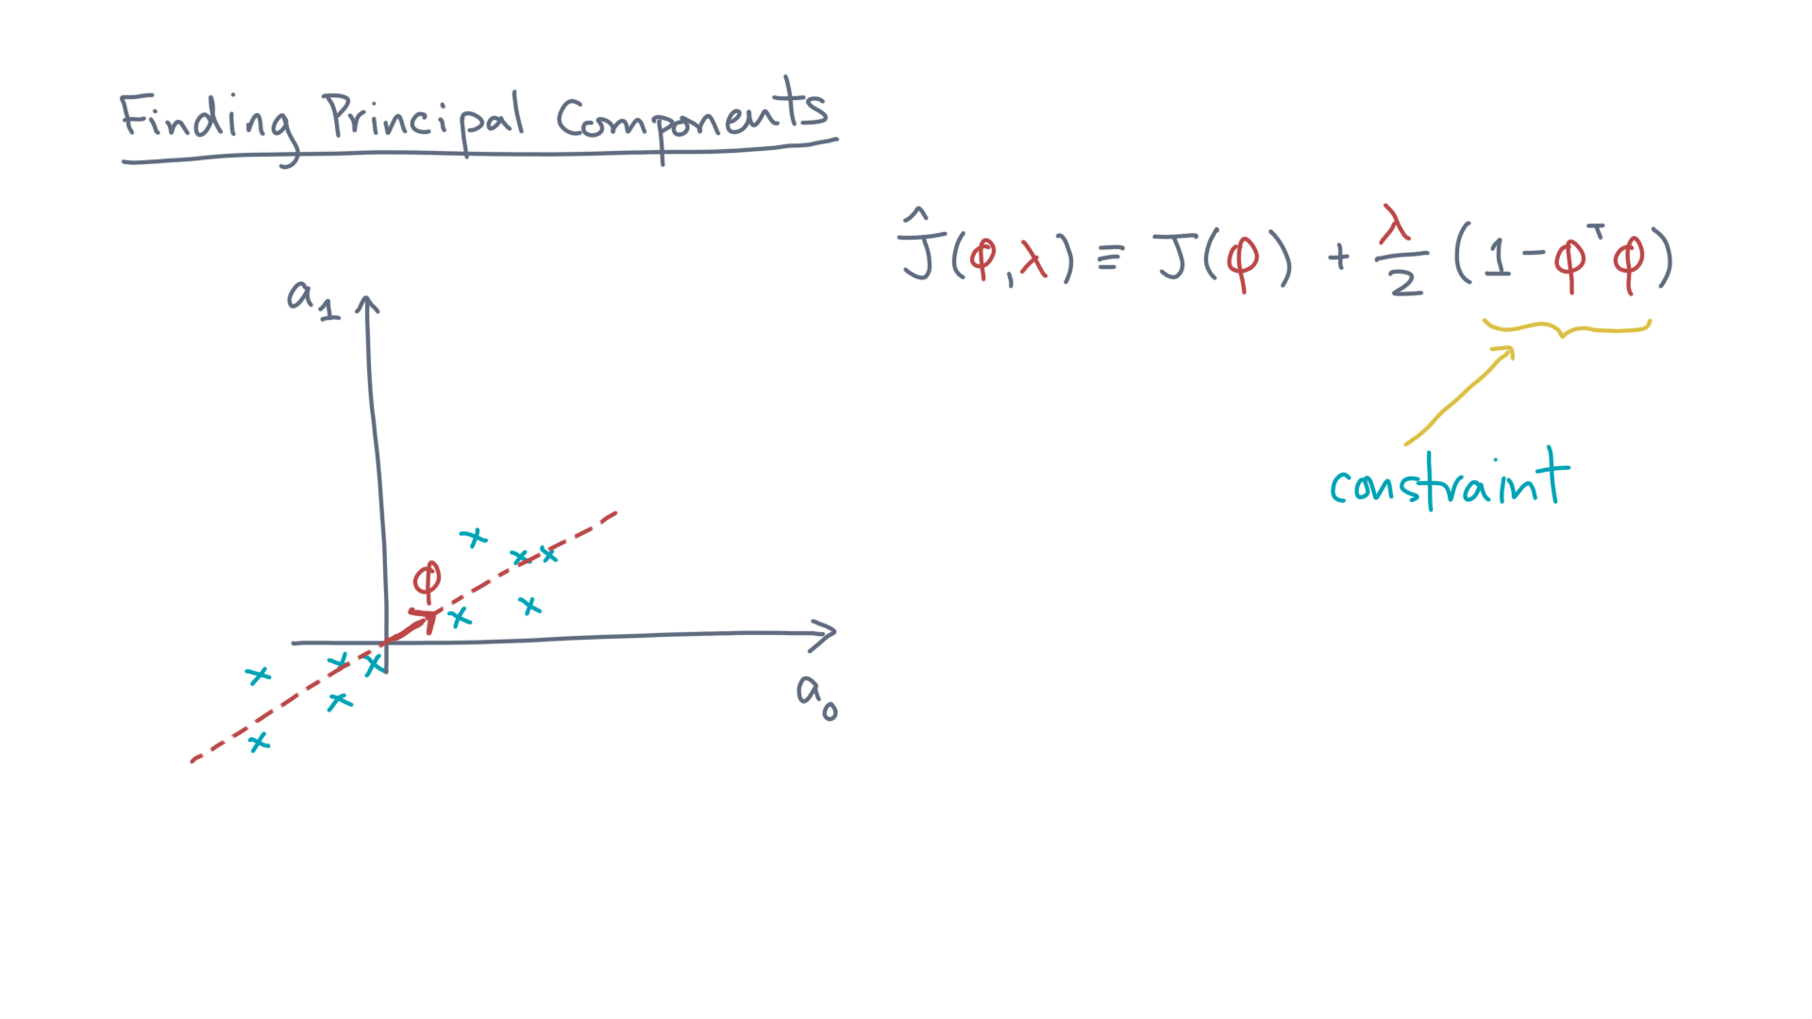
Notes:
The inner-part of the term is just another way to express the original constraint. @TODO: Highlight/write
When it is satisfied, then it makes the term zero.
In that case, J-hat is equivalent to J and the specific value of “lambda” doesn’t otherwise matter.

Slide 21
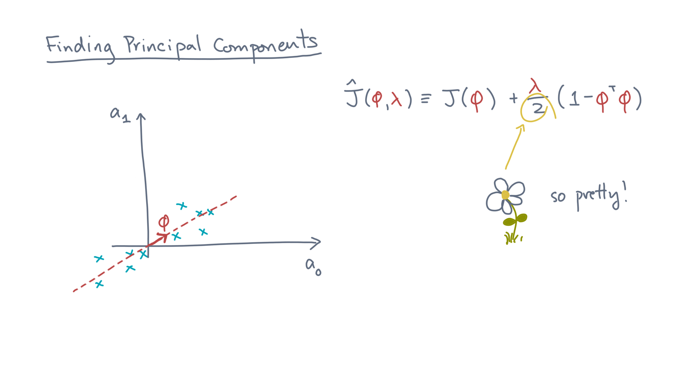
Notes:
Lastly, there is the one-half.
It is a purely aesthetic constant to make the math look cleaner later on.

Slide 22
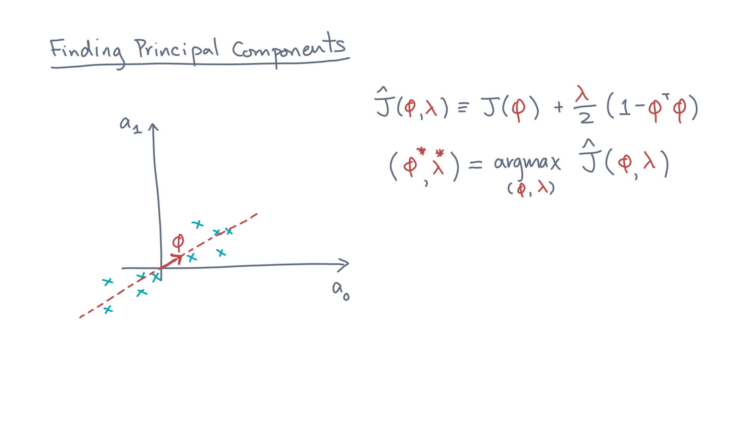
Notes:
Now, let’s see what happens when you try to maximize this function. @TODO: Clear screen? Write new optimization function

Slide 23
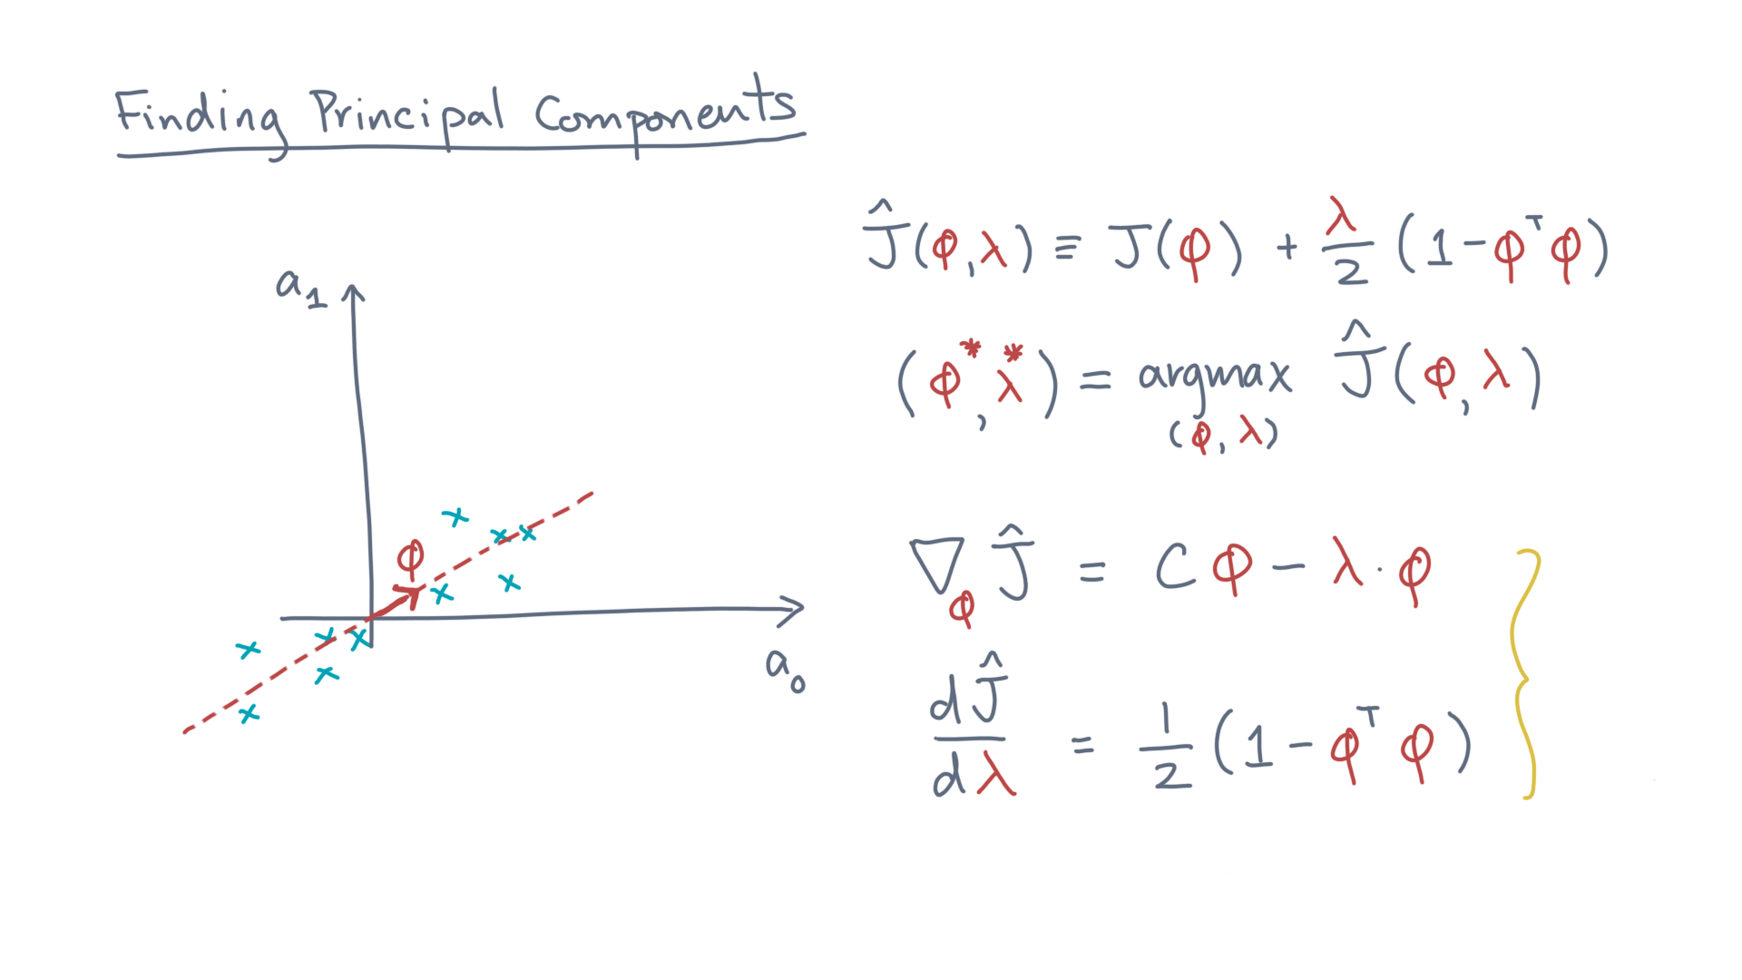
Notes:
You’ll need to take the gradients with respect to the parameters, phi and lambda. @TODO: Show
Try to show these as an exercise.

Slide 24
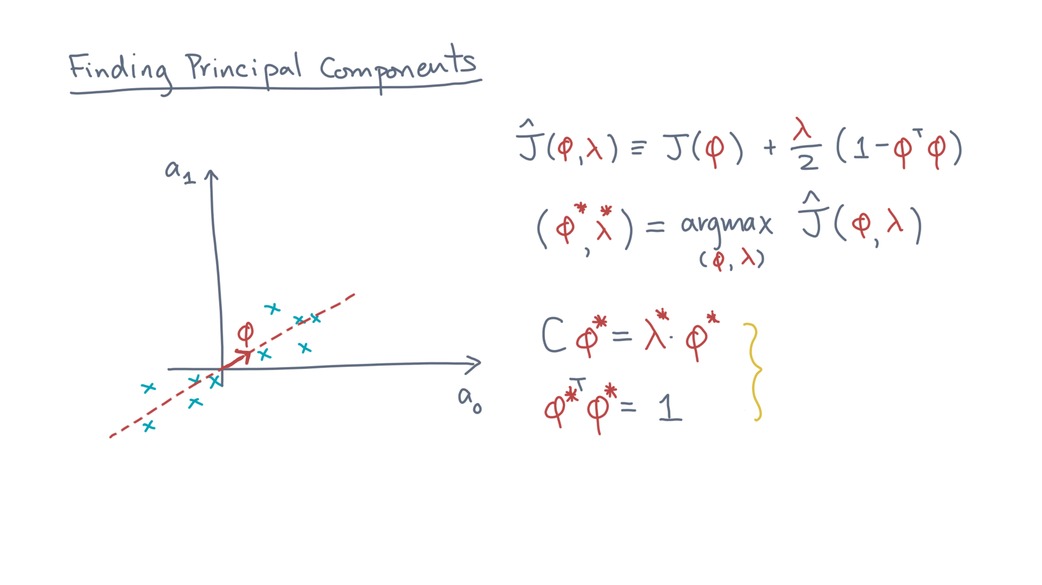
Notes:
Setting these to zero and solving yields the following computational problem: @TODO Show

Slide 25
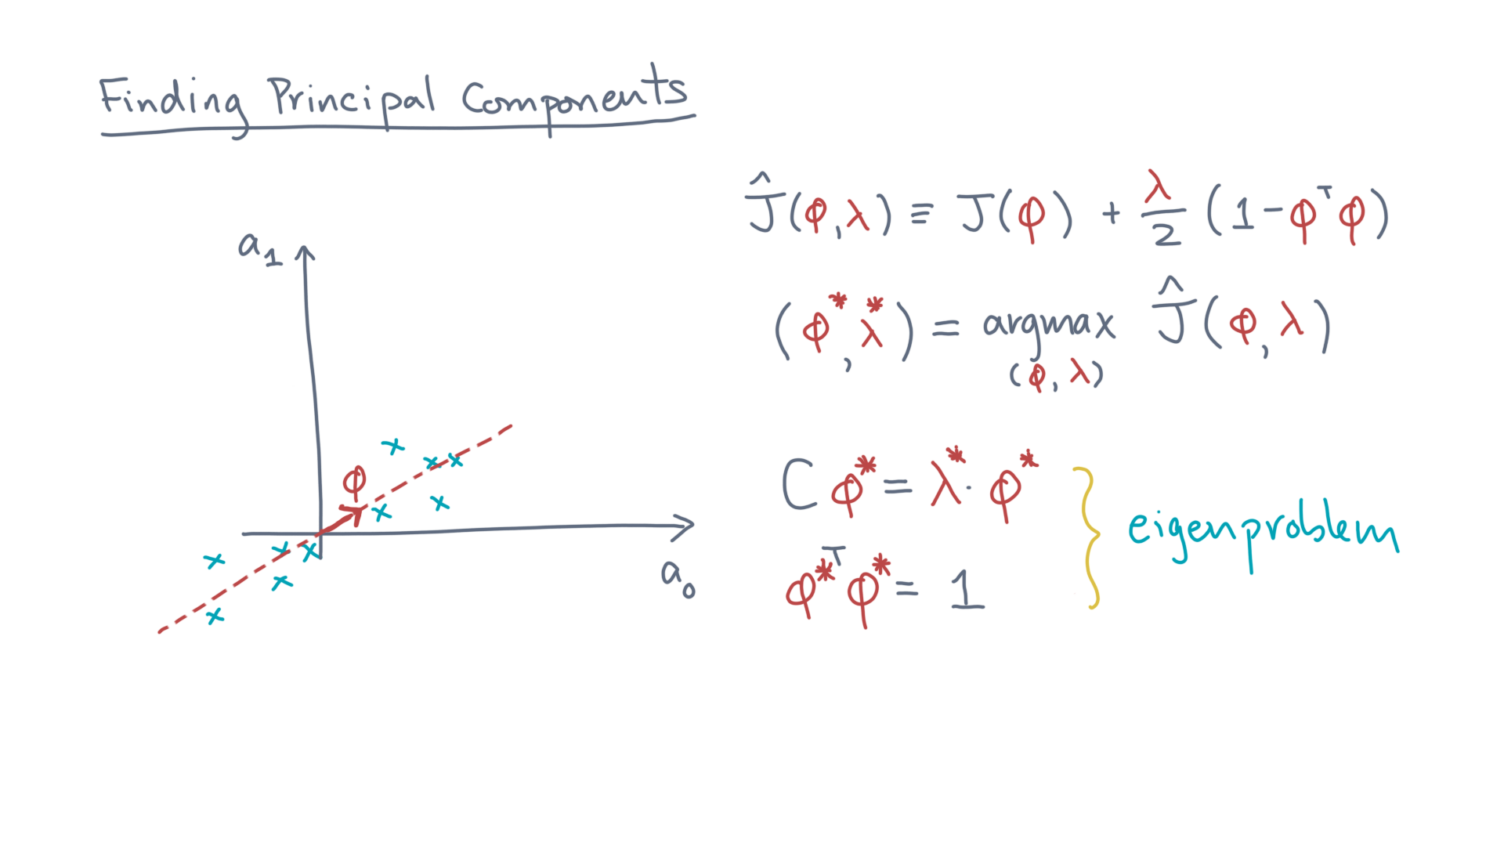
Notes:
I hope these equations have a familiar form, from linear algebra.
They define an “eigenproblem.”

Slide 26
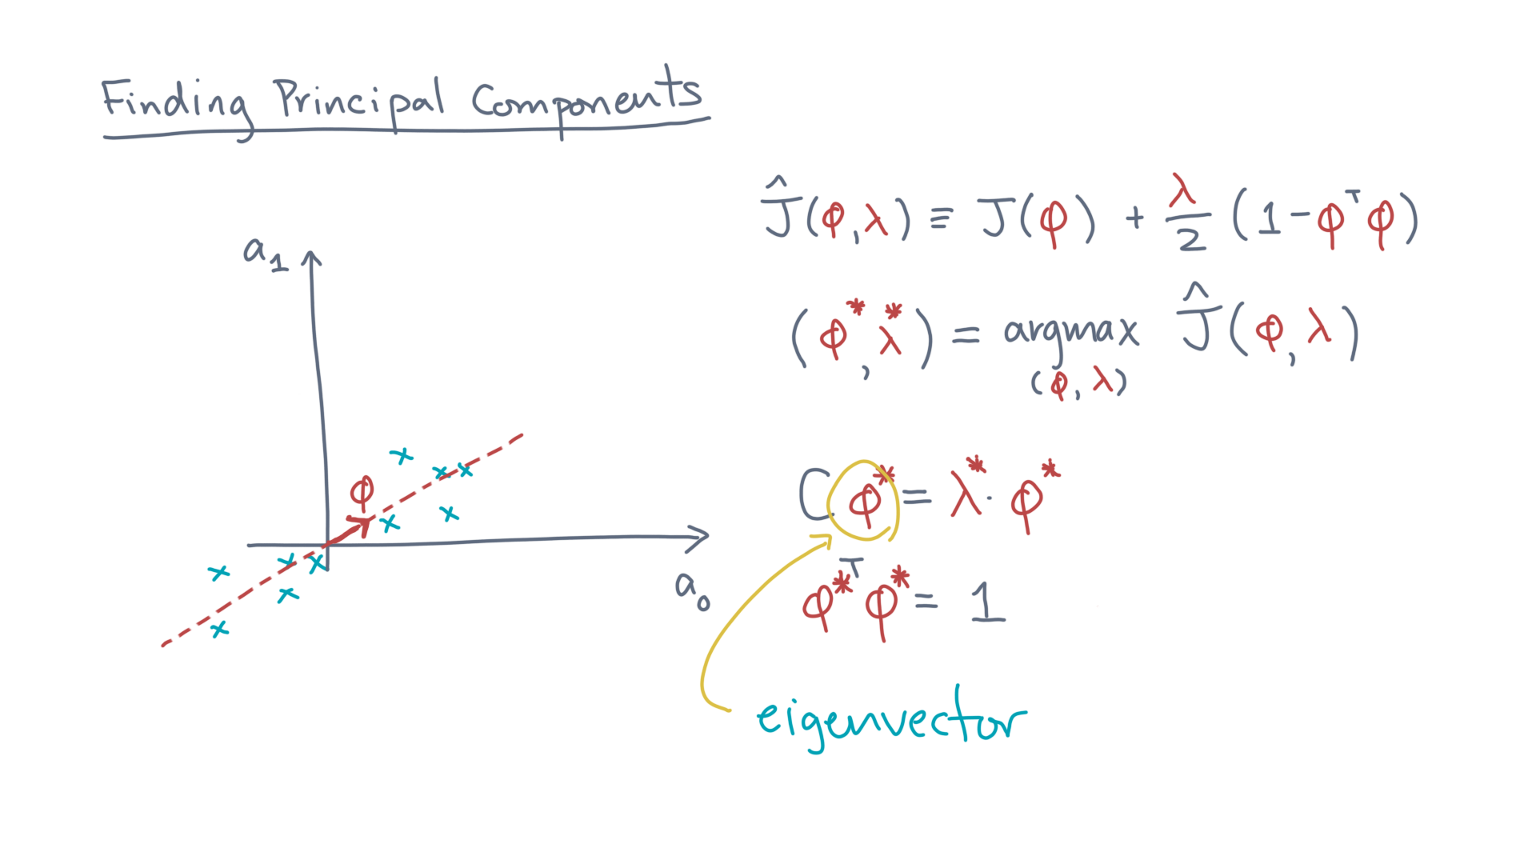
Notes:
Solving it, the resulting phi is an eigenvector. @TODO: Show /write

Slide 27
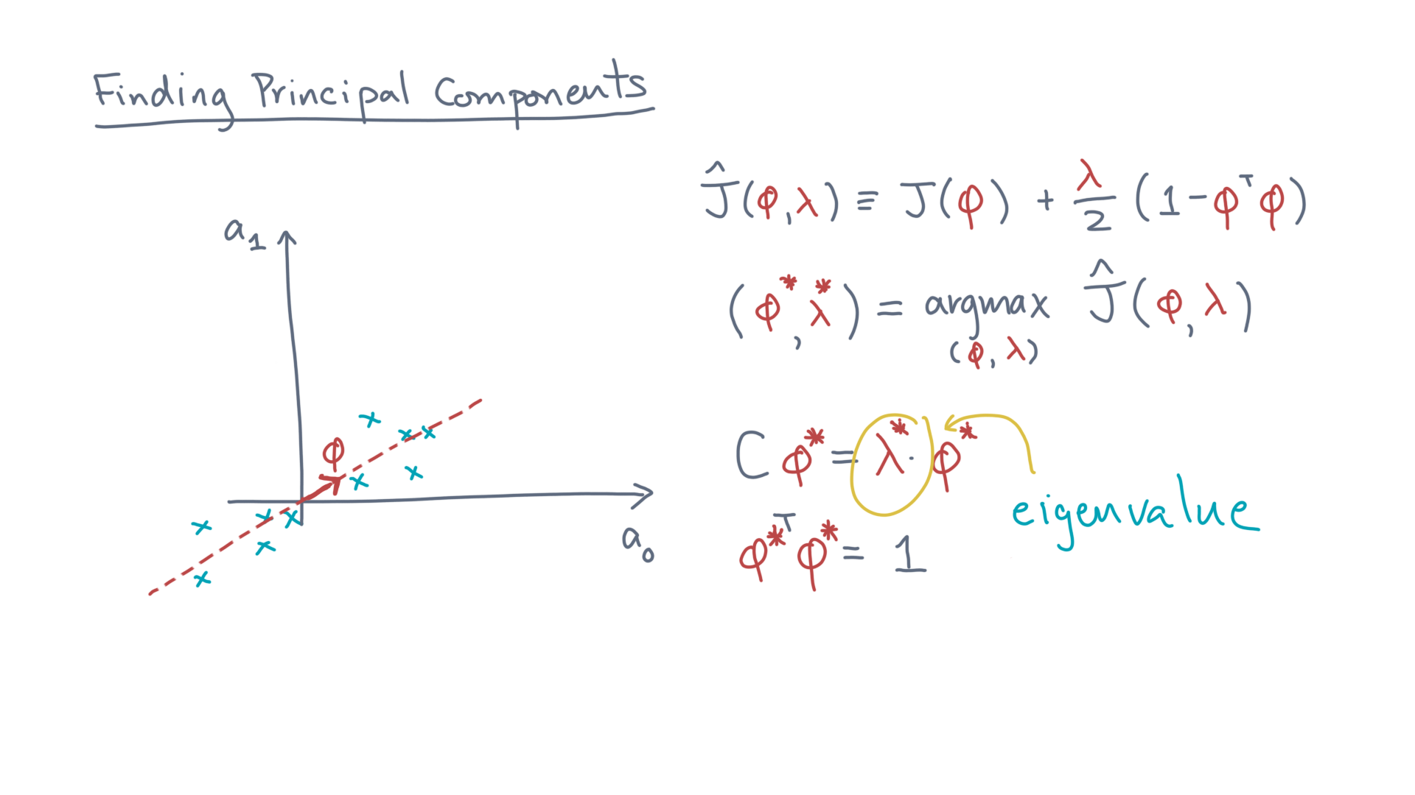
Notes:
Lambda is the corresponding eigenvalue. @TODO: Show, highlight

Slide 28
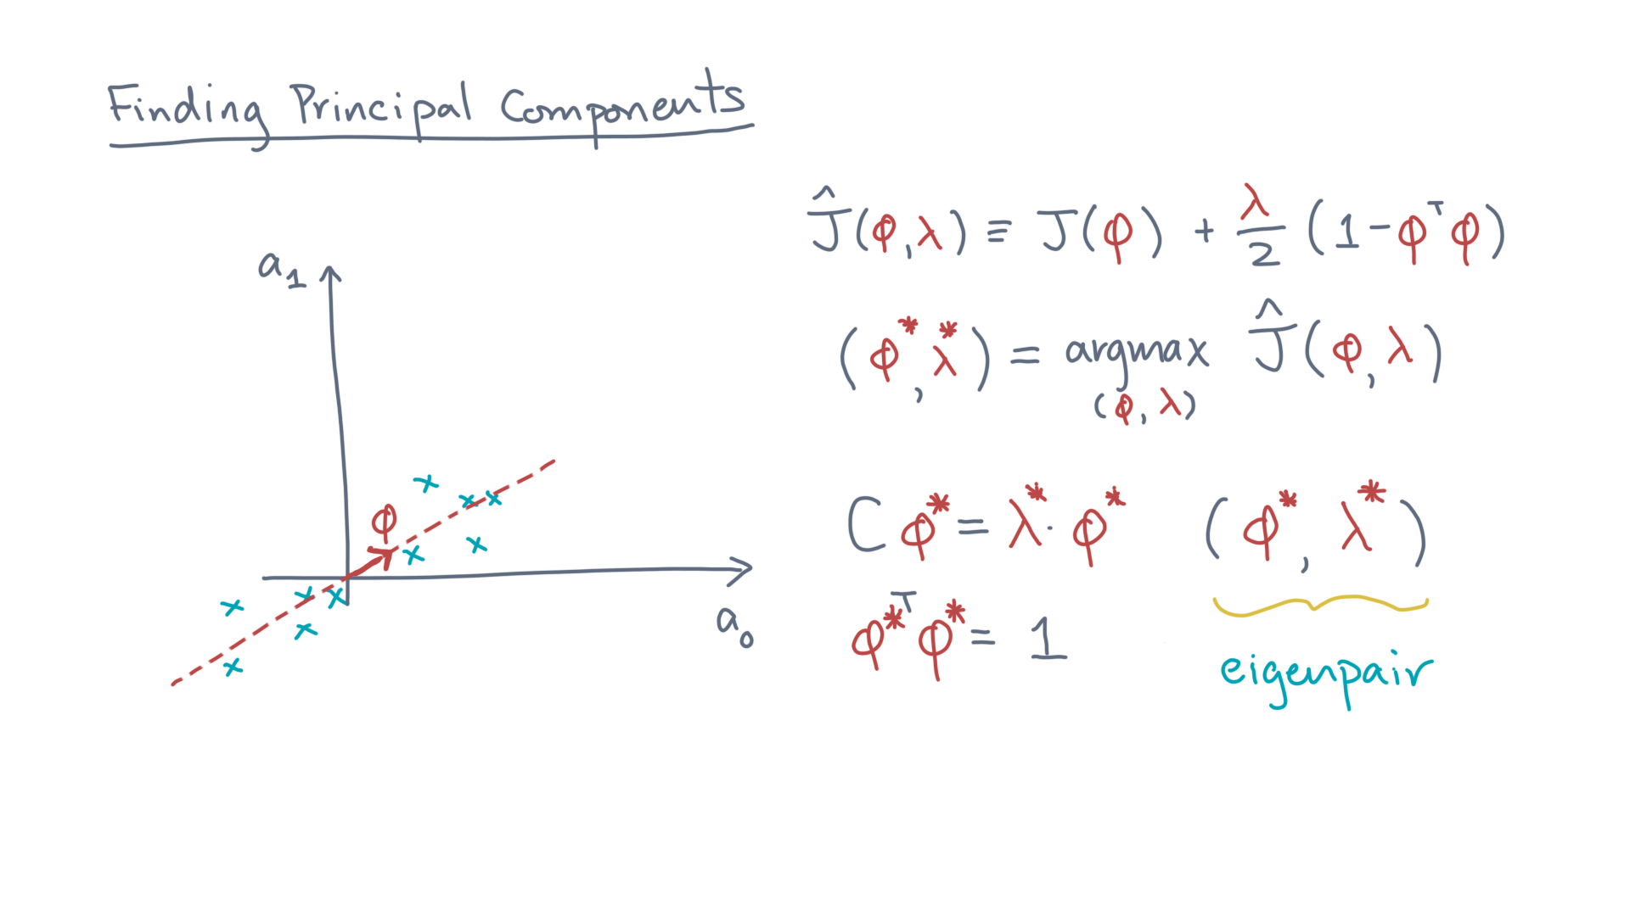
Notes:
Together, phi and lambda form an *eigenpair.* @TODO: Show / highlight / write “eigenpair”

Slide 29
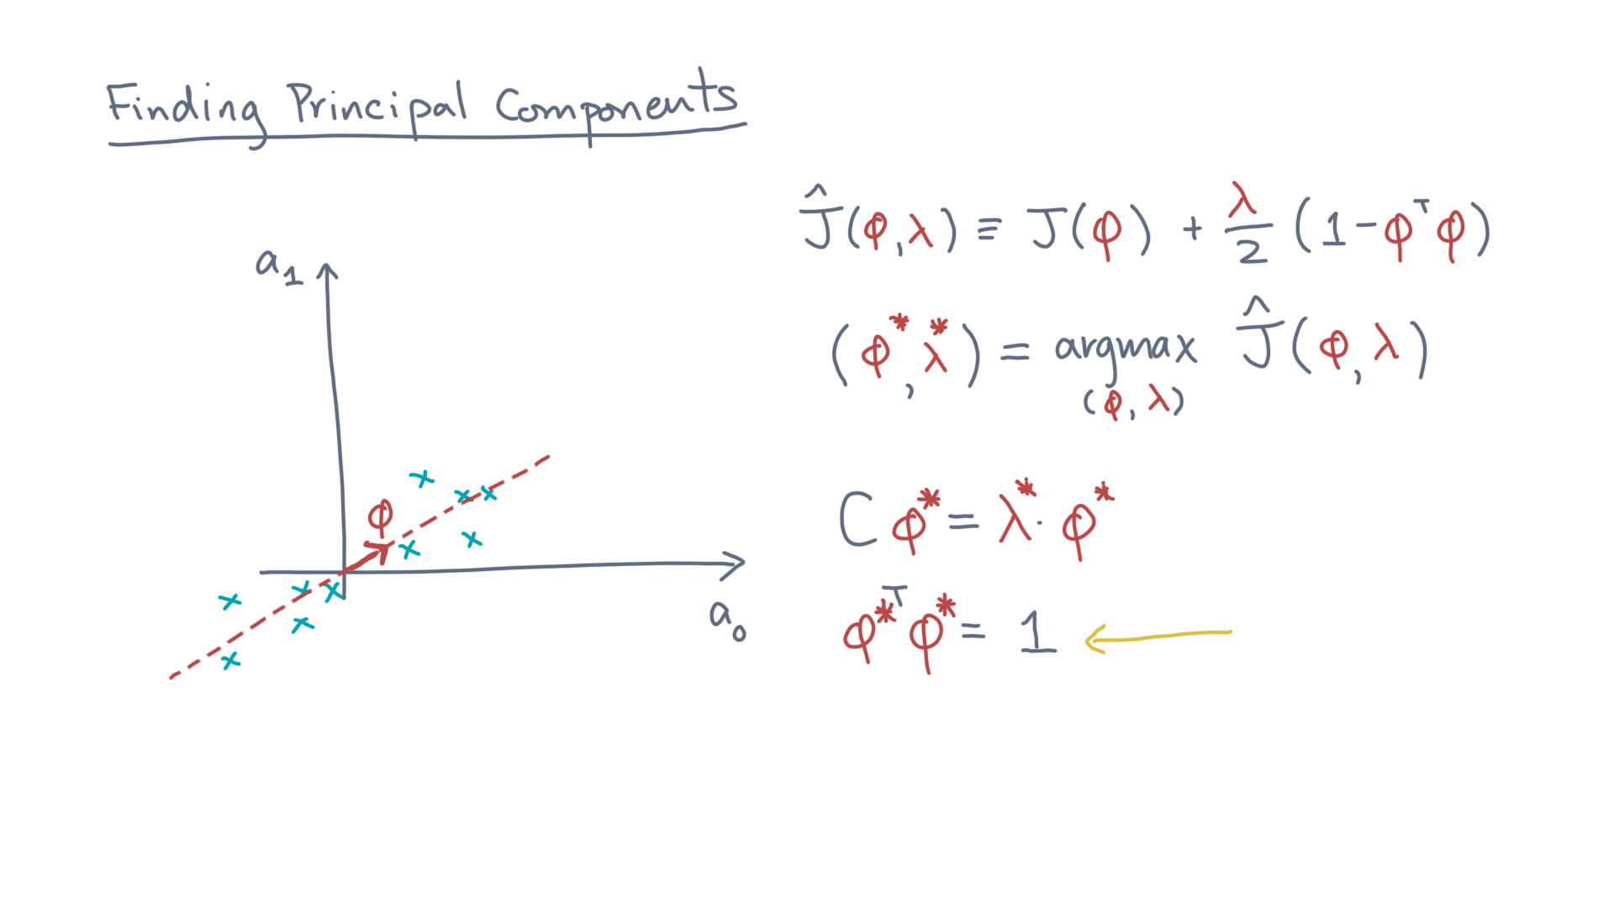
Notes:
What about the second equation? @TODO: Highlight
It just expresses exactly the constraint on phi, that it have unit length.
The standard eigenproblem seeks orthogonal vectors, so this equation is compatible with that requirement.

Slide 30
Notes:
Okay, you are making great progress toward developing an algorithm for compression!
A one-line summary is that the problem of finding a projection-maximizing axis reduces to an eigenproblem.
Think of “projection” as a way to reduce a dataset to a lower-dimensional representation that tries to preserve the “mass” of the data.

Slide 31
Notes:
So, take a moment to review these notes and peek at the accompanying notebook, which will help reinforce what we just discussed.
And as always, happy studying and coding!

